Slide 1

Implement 128-bit AES algorithm on FPGA board using Verilog hardware coding (only encryption part)
Play In Slide Show Mode Only
Shashank Soni
(20116090) - O8
Sainath Rao P
(20116094) - O8
Yash Raj
(20116110) - O8
Team
Tadiparthi Aditya (20116098) - O8
Dishant Meena
(20116030) - O6

Slide 2
> Problem Statement
> Block Diagram
> Algorithm
AES
Advanced Encryption Standard - 128 Bit
> Flow Chart
> Timeline
> Role of Co-Players

Slide 3

Problem Statement
Implement 128-bit AES
(Advanced Encryption Standard) algorithm on FPGA board using Verilog hardware coding
(only encryption part).

Slide 4

Block Diagram

Slide 5

Flow Chart

Slide 6
Terminologies
> Ciphertext : Randomly generated 128-bit text string.
> Key: A 4x4 hexadecimal matrix generated from ciphertext. Each round has its separate round key.
> State matrix: A 4x4 hexadecimal matrix of input plain text.
> Word column: Each column of key is referred to as a word, so a key is of four words namely w_{[0]}, w_{[1]}, w_{[2]}, w_{[3]}.
> S-box: Predefined 16x16 matrix having permutations of all hexadecimal characters.
> Round constant matrix (rcon matrix): Predefined 4x10 matrix. Each round has a separate rcon value which is used in XOR operation to generate round keys.
> Mix-column matrix: Constant matrix used in mix column operation for matrix multiplication.

Slide 7

Algorithm / Steps
> Step 1 :Take 128-bit plain text input, ciphertext as input.
> Step 2 : Represent the input and ciphertext in 4x4 matrix, such that each cell is of 1 byte size.
> Step 3 : Convert the plain text and ciphertext into hexadecimal representation.
Description Of Each Round

Slide 8
Key Generation
Each round key is generated from previous round key by performing following steps.
Let w = {67, 20, 46, 75}
> Step 1 : Left shift the last column (w) of previous round key by 1 unit. Let us call the modified word as x.
X = {20, 46, 75, 67}
> Step 2 : Substitute each cell of the x with corresponding bytes in S-box, name it as y.
Y = {B7, 5A, 9D,85}
> Step 3 : Take XOR with the round constant (z).
> Step 4. Let the word number be i (w_{[i]}). 0 <= i <= 3;
If i is multiple of 4, then w_{[i]} = w_{[i-4]} ^ z.
Otherwise, w_{[i]} = w_{[i - 1]} ^ w_{[i - 4]}.
This round key is used in further steps for encryption.

Slide 9
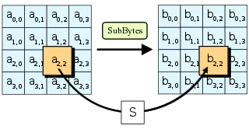
Substitute bytes
In the state matrix each cell has 8 bits. (a₇ a₆ a₅ a₄….. a₀).
> Step 1 : Divide it into two parts i.e.., a₇ to a₄(let say x) and a₃ to a₀(let say y). The first four bits (a₇-a₄) represents the row number whereas the other four bits(a₃-a₀) represent the column number in S-box.
> Step 2 : Replace each cell of state matrix with the corresponding S-box cell.

Slide 10
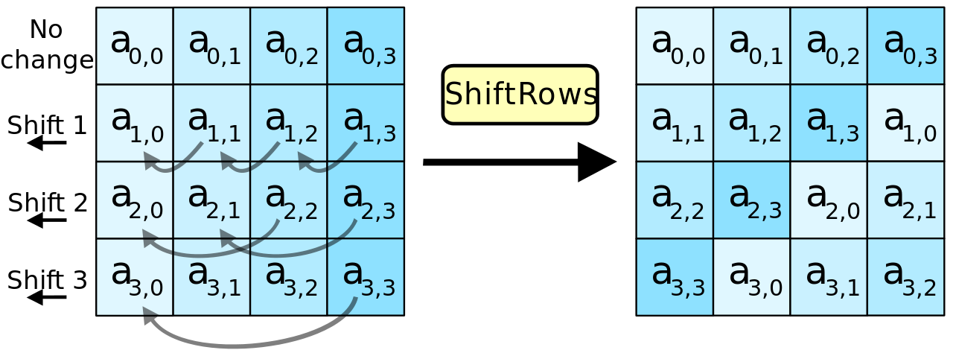
Shifting Rows
> First row is not shifted.
> Second row is shifted one unit.
> Third row is shifted two units.
> Fourth row is shifted three units.
Traverse through the four rows and take the j value for each row in S_{i,j} notation of state matrix. Now take the first j units from the left end and insert at the right after the row ends and the final array results in the following way.
No Change
Shift 1
Shift 2
Shift 3

Slide 11
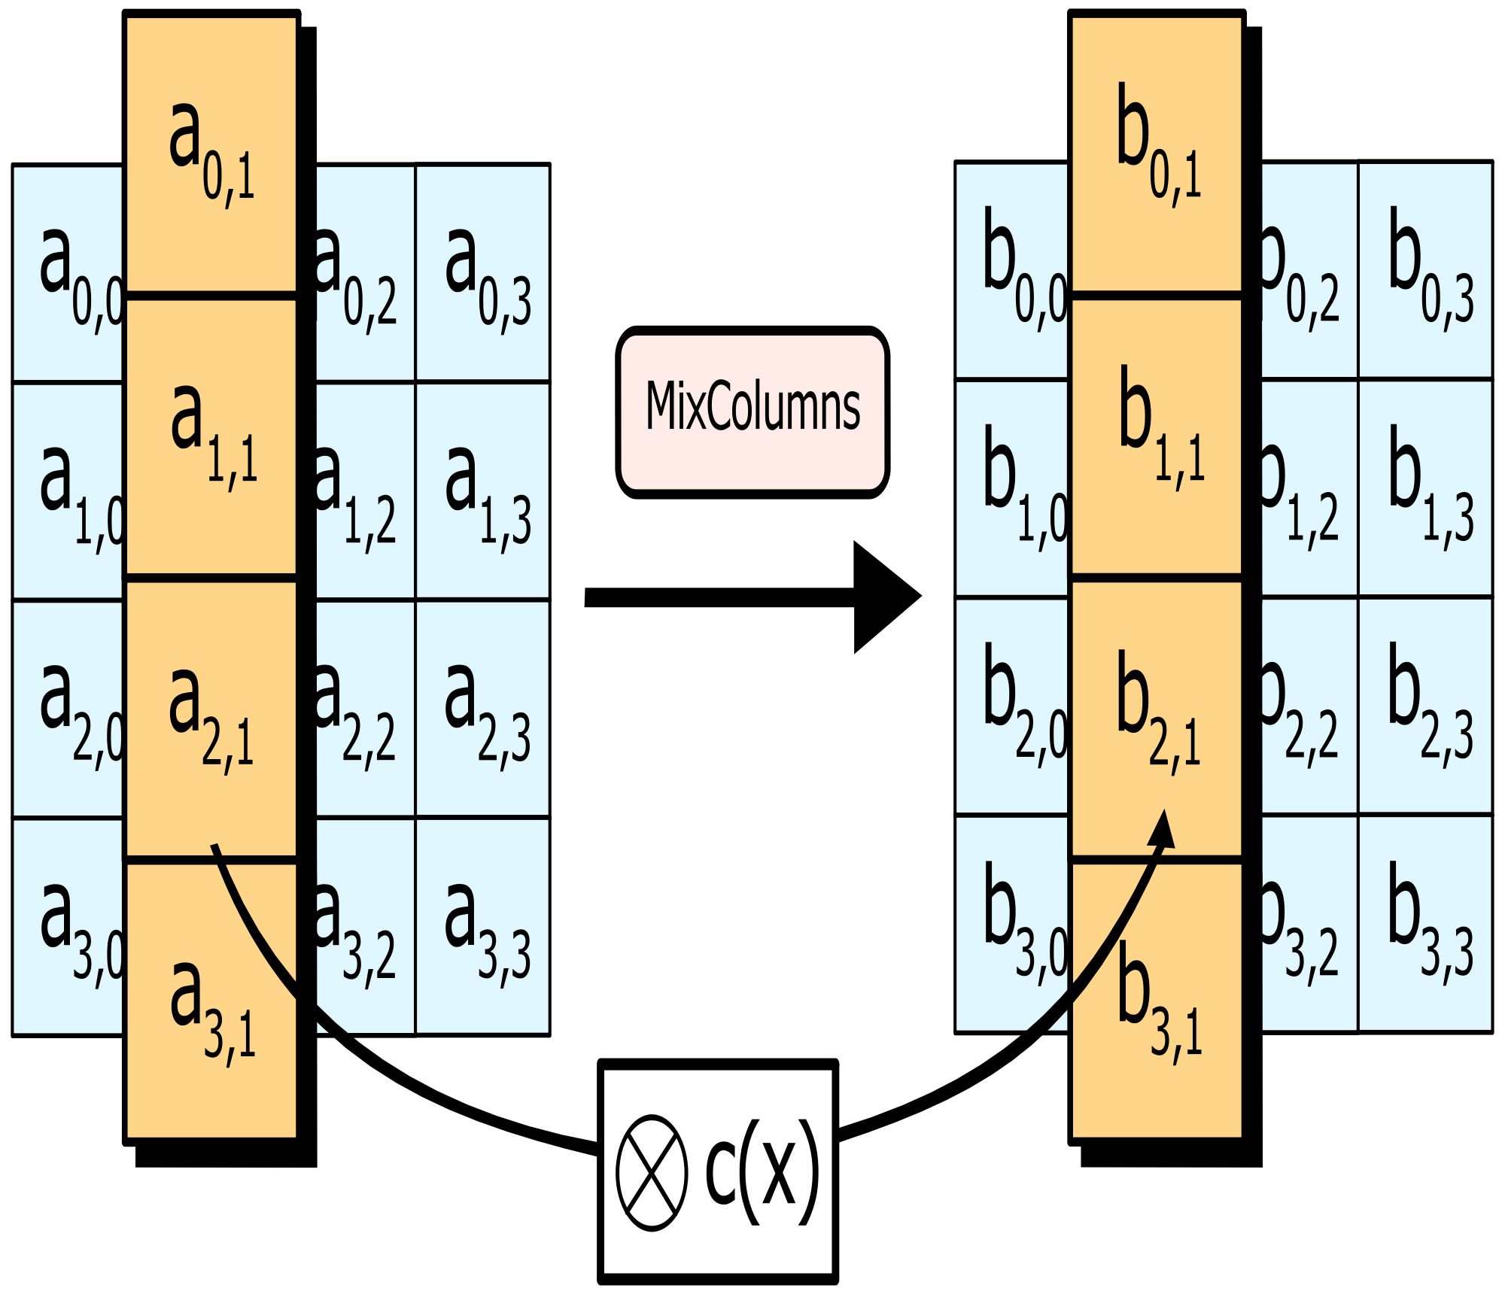
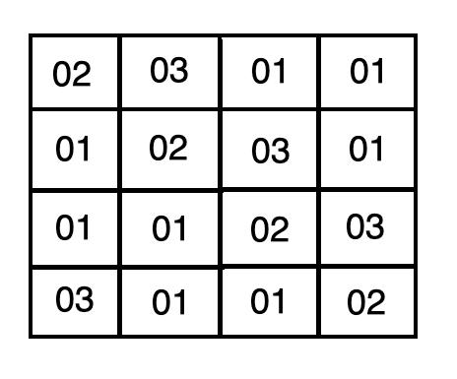
Mix-column operation
Perform matrix multiplication between state matrix and a constant matrix.
Eg : b_{0,1} = 02 x a_{0,1} + 03 x a_{1,1} + 01 x a_{2,1} + 01 x a_{3,1}

Slide 12
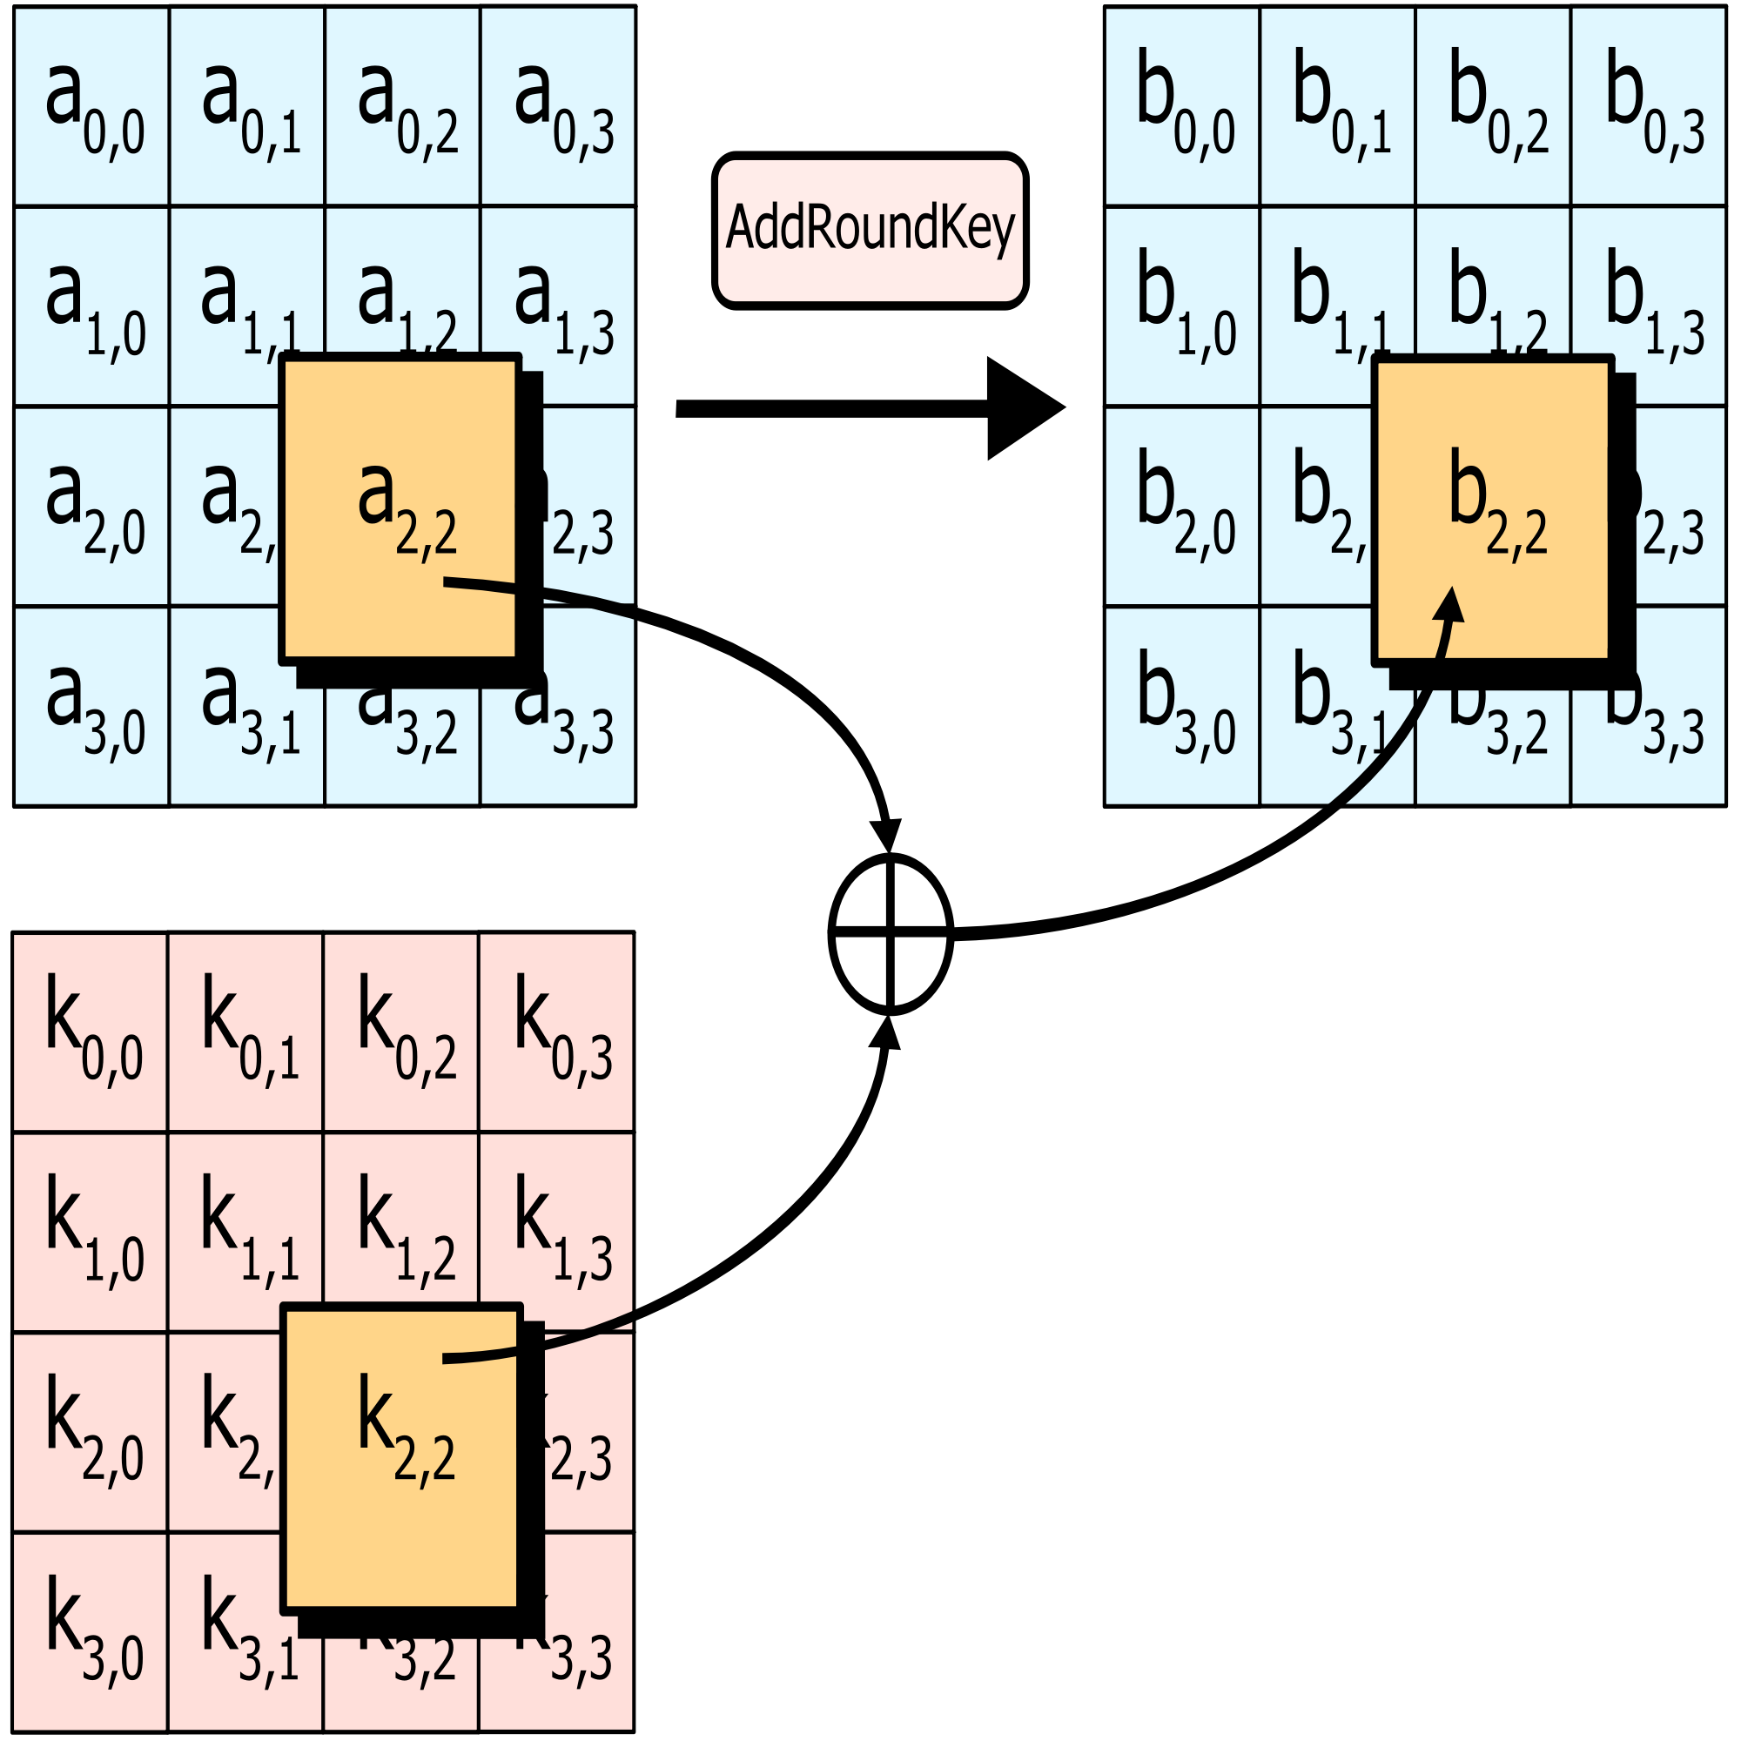
Add Round key
Perform XOR operation of each byte with corresponding bytes in round key
This modified state matrix is then further encrypted in next rounds.

Slide 13

Initial Round
> Do XOR operation of initial state matrix and cipher key K₀.
> XOR corresponding cells of state matrix and K₀ matrix.
> The new state matrix will be passed for further rounds(Round 1 - Round 10).

Slide 14
Intermediate Rounds
Intermediate Rounds (Round 1- Round 9)
> Step a : Repeat step b to step e .
> Step b : Perform subyte operation.
> Step c : Perform shift row operation.
> Step d : Perform Mix column operation.
> Step e : Perform Add Round key operation.

Slide 15
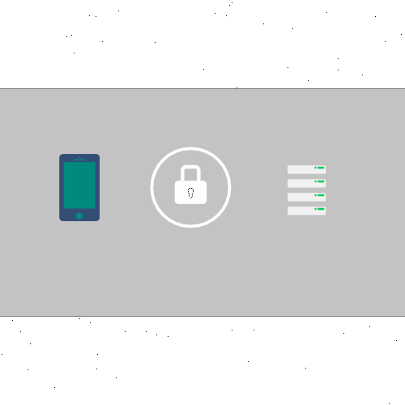
Final Round
> Step a : Perform Subyte operation.
> Step b : Perform Shift row operation.
> Step c : Perform Add Round key operation.
> Final state matrix is the encrypted message :)
Plaintext
Encrytion
Cipher Text

Slide 16
RTL Verilog Code
> AESCIPHER.V
`timescale 1ns / 1ps
module AES_encryption(clock, plain_text, c_key, dataout);
input clock;
input [127:0] plain_text, c_key;
output [127:0] dataout;
wire [127:0] r0_out, r1_out, r2_out, r3_out, r4_out, r5_out, r6_out, r7_out, r8_out, r9_out;
wire [127:0] keyout1, keyout2, keyout3, keyout4, keyout5, keyout6, keyout7, keyout8, keyout9;
assign r0_out = c_key ^ plain_text;
Round R1(.clock(clock), .rc(4'b0001), .stateMatrix(r0_out), .in_key(c_key), .out_key(keyout1), .round_out(r1_out));
Round R2(.clock(clock), .rc(4'b0010), .stateMatrix(r1_out), .in_key(keyout1), .out_key(keyout2), .round_out(r2_out));
Round R3(.clock(clock), .rc(4'b0011), .stateMatrix(r2_out), .in_key(keyout2), .out_key(keyout3), .round_out(r3_out));
Round R4(.clock(clock), .rc(4'b0100), .stateMatrix(r3_out), .in_key(keyout3), .out_key(keyout4), .round_out(r4_out));
Round R5(.clock(clock), .rc(4'b0101), .stateMatrix(r4_out), .in_key(keyout4), .out_key(keyout5), .round_out(r5_out));
Round R6(.clock(clock), .rc(4'b0110), .stateMatrix(r5_out), .in_key(keyout5), .out_key(keyout6), .round_out(r6_out));
Round R7(.clock(clock), .rc(4'b0111), .stateMatrix(r6_out), .in_key(keyout6), .out_key(keyout7), .round_out(r7_out));
Round R8(.clock(clock), .rc(4'b1000), .stateMatrix(r7_out), .in_key(keyout7), .out_key(keyout8), .round_out(r8_out));
Round R9(.clock(clock), .rc(4'b1001), .stateMatrix(r8_out), .in_key(keyout8), .out_key(keyout9), .round_out(r9_out));
finalRound R10(.clock(clock), .rc(4'b1010), .rin(r9_out), .finalKey(keyout9), .final_out(dataout));
endmodule

Slide 17
RTL Verilog Code
> ROUND.V
`timescale 1ns / 1ps
module Round(clock, rc, stateMatrix, in_key, out_key, round_out);
input clock;
input [3:0] rc;
input [127:0] stateMatrix, in_key;
output [127:0]out_key, round_out;
wire [127:0] MixClm, sb ,shiftedRow;
KeyGeneration k(rc, in_key, out_key);
subbytes sub(stateMatrix, sb);
shiftrow sft(sb, shiftedRow);
mixcolumn mx(shiftedRow, MixClm);
assign round_out = MixClm ^ out_key;
endmodule

Slide 18
RTL Verilog Code
> FINALROUND.V
`timescale 1ns / 1ps
module finalRound(clock, rc, rin, finalKey, final_out);
input clock;
input [3:0] rc;
input [127:0] rin, finalKey;
output [127:0] final_out;
wire [127:0] sb, shiftedRow, MixClm, out_key;
KeyGeneration k(rc, finalKey, out_key);
subbytes sub(rin, sb);
shiftrow sft(sb, shiftedRow);
assign final_out= shiftedRow ^ out_key;
endmodule

Slide 19
RTL Verilog Code
> KEYGENERATION.V
`timescale 1ns / 1ps
module KeyGeneration(rc, in_key, out_key);
input [3:0] rc;
input [127:0] in_key;
output [127:0] out_key;
wire [31:0] word0, word1, word2, word3, temp;
assign word0 = in_key[127:96];
assign word1 = in_key[95:64];
assign word2 = in_key[63:32];
assign word3 = in_key[31:0];
sbox a1(.inputByte(word3[23:16]), .substitutedByte(temp[31:24]));
sbox a2(.inputByte(word3[15:8]), .substitutedByte(temp[23:16]));
sbox a3(.inputByte(word3[7:0]), .substitutedByte(temp[15:8]));
sbox a4(.inputByte(word3[31:24]), .substitutedByte(temp[7:0]));
assign out_key[127:96] = word0 ^ temp ^ rcon(rc);
assign out_key[95:64] = word0 ^ word1 ^ temp ^ rcon(rc);
assign out_key[63:32] = word0 ^ word1 ^ word2 ^ temp ^ rcon(rc);
assign out_key[31:0] = word0 ^ word1 ^ word2 ^ word3 ^ temp ^ rcon(rc);
function [31:0] rcon;
input [3:0] rc;
case(rc)
4'h1: rcon=32'h01_00_00_00;
4'h2: rcon=32'h02_00_00_00;
4'h3: rcon=32'h04_00_00_00;
4'h4: rcon=32'h08_00_00_00;
4'h5: rcon=32'h10_00_00_00;
4'h6: rcon=32'h20_00_00_00;
4'h7: rcon=32'h40_00_00_00;
4'h8: rcon=32'h80_00_00_00;
4'h9: rcon=32'h1b_00_00_00;
4'ha: rcon=32'h36_00_00_00;
default: rcon=32'h00_00_00_00;
endcase
endfunction
endmodule

Slide 20
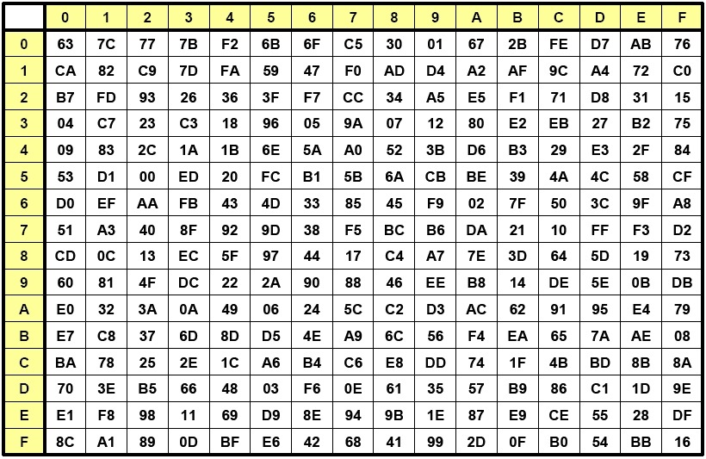
RTL Verilog Code
> SBOX.V
`timescale 1ns / 1ps
module sbox(inputByte, substitutedByte);
input [7:0] inputByte;
output [7:0] substitutedByte;
reg [7:0] substitutedByte;
always @(inputByte)
case (inputByte)
8'h00: substitutedByte =8'h63;
8'h01: substitutedByte=8'h7c;
8'h02: substitutedByte=8'h77;
8'h03: substitutedByte=8'h7b;
..
..
..
..
..
8'hfa: substitutedByte=8'h2d;
8'hfb: substitutedByte=8'h0f;
8'hfc: substitutedByte=8'hb0;
8'hfd: substitutedByte=8'h54;
8'hfe: substitutedByte=8'hbb;
8'hff: substitutedByte=8'h16;
endcase
endmodule

Slide 21
RTL Verilog Code
> MIXCOLUMN.V
`timescale 1ns / 1ps
module mixcolumn(shiftedRow, MixClm);
input [127:0] shiftedRow;
output [127:0] MixClm;
assign MixClm[127:120]= mixcolumn32 (shiftedRow[127:120], shiftedRow[119:112], shiftedRow[111:104], shiftedRow[103:96]);
assign MixClm[119:112]= mixcolumn32 (shiftedRow[119:112], shiftedRow[111:104], shiftedRow[103:96], shiftedRow[127:120]);
assign MixClm[111:104]= mixcolumn32 (shiftedRow[111:104],shiftedRow[103:96],shiftedRow[127:120],shiftedRow[119:112]);
assign MixClm[103:96]= mixcolumn32 (shiftedRow[103:96],shiftedRow[127:120],shiftedRow[119:112],shiftedRow[111:104]);
assign MixClm[95:88]= mixcolumn32 (shiftedRow[95:88], shiftedRow[87:80], shiftedRow[79:72], shiftedRow[71:64]);
assign MixClm[87:80]= mixcolumn32 (shiftedRow[87:80], shiftedRow[79:72], shiftedRow[71:64], shiftedRow[95:88]);
assign MixClm[79:72]= mixcolumn32 (shiftedRow[79:72], shiftedRow[71:64], shiftedRow[95:88], shiftedRow[87:80]);
assign MixClm[71:64]= mixcolumn32 (shiftedRow[71:64], shiftedRow[95:88], shiftedRow[87:80], shiftedRow[79:72]);
assign MixClm[63:56]= mixcolumn32 (shiftedRow[63:56], shiftedRow[55:48], shiftedRow[47:40], shiftedRow[39:32]);
assign MixClm[55:48]= mixcolumn32 (shiftedRow[55:48], shiftedRow[47:40], shiftedRow[39:32], shiftedRow[63:56]);
assign MixClm[47:40]= mixcolumn32 (shiftedRow[47:40], shiftedRow[39:32], shiftedRow[63:56], shiftedRow[55:48]);
assign MixClm[39:32]= mixcolumn32 (shiftedRow[39:32], shiftedRow[63:56], shiftedRow[55:48], shiftedRow[47:40]);
assign MixClm[31:24]= mixcolumn32 (shiftedRow[31:24], shiftedRow[23:16], shiftedRow[15:8], shiftedRow[7:0]);
assign MixClm[23:16]= mixcolumn32 (shiftedRow[23:16], shiftedRow[15:8], shiftedRow[7:0], shiftedRow[31:24]);
assign MixClm[15:8]= mixcolumn32 (shiftedRow[15:8], shiftedRow[7:0], shiftedRow[31:24], shiftedRow[23:16]);
assign MixClm[7:0]= mixcolumn32 (shiftedRow[7:0], shiftedRow[31:24], shiftedRow[23:16], shiftedRow[15:8]);
function [7:0] mixcolumn32;
input [7:0] in1, in2, in3, in4;
begin
mixcolumn32[7] = in1[6] ^ in2[6] ^ in2[7] ^ in3[7] ^ in4[7];
mixcolumn32[6] = in1[5] ^ in2[5] ^ in2[6] ^ in3[6] ^ in4[6];
mixcolumn32[5] = in1[4] ^ in2[4] ^ in2[5] ^ in3[5] ^ in4[5];
mixcolumn32[4] = in1[3] ^ in1[7] ^ in2[3] ^ in2[4] ^ in2[7] ^ in3[4] ^ in4[4];
mixcolumn32[3] = in1[2] ^ in1[7] ^ in2[2] ^ in2[3] ^ in2[7] ^ in3[3] ^ in4[3];
mixcolumn32[2] = in1[1] ^ in2[1] ^ in2[2] ^ in3[2] ^ in4[2];
mixcolumn32[1] = in1[0] ^ in1[7] ^ in2[0] ^ in2[1] ^ in2[7] ^ in3[1] ^ in4[1];
mixcolumn32[0] = in1[7] ^ in2[7] ^ in2[0] ^ in3[0] ^ in4[0];
end
endfunction
endmodule

Slide 22
RTL Verilog Code
> SHIFTROW.V
`timescale 1ns / 1ps
module shiftrow(sb,shiftedRow);
input [127:0] sb;
output [127:0] shiftedRow;
assign shiftedRow[7:0] = sb[39:32];
assign shiftedRow[15:8] = sb[79:72];
assign shiftedRow[23:16] = sb[119:112];
assign shiftedRow[31:24] = sb[31:24];
assign shiftedRow[39:32] = sb[71:64];
assign shiftedRow[47:40] = sb[111:104];
assign shiftedRow[55:48] = sb[23:16];
assign shiftedRow[63:56] = sb[63:56];
assign shiftedRow[71:64] = sb[103:96];
assign shiftedRow[79:72] = sb[15:8];
assign shiftedRow[87:80] = sb[55:48];
assign shiftedRow[95:88] = sb[95:88];
assign shiftedRow[103:96] = sb[7:0];
assign shiftedRow[111:104] = sb[47:40];
assign shiftedRow[119:112] = sb[87:80];
assign shiftedRow[127:120] = sb[127:120];
endmodule

Slide 23
RTL Verilog Code
> AES_TB.V
_{`timescale 1ns / 1ps}
_{module AES_testbench;}
_{reg clock;}
_{reg [127:0] plain_text, c_key;}
_{wire [127:0] encryptedKey;}
AES_encryption u1(.clock(clock), .plain_text(plain_text), .c_key(c_key), .dataout(encryptedKey));
_{initial}
_{begin}
_{clock = 0;}
plain_text = 128'h00112233445566778899aabbccddeeff;
c_key = 128'h000102030405060708090a0b0c0d0e0f;
_{#50;}
plain_text = 128'h54776F204F6E65204E696E652054776F;
c_key = 128'h5468617473206D79204B756E67204675;
_{#50;}
plain_text = 128'h3243f6a8885a308d313198a2e0370734;
c_key = 128'h2b7e151628aed2a6abf7158809cf4f3c;
_{end}
_{endmodule}

Slide 24
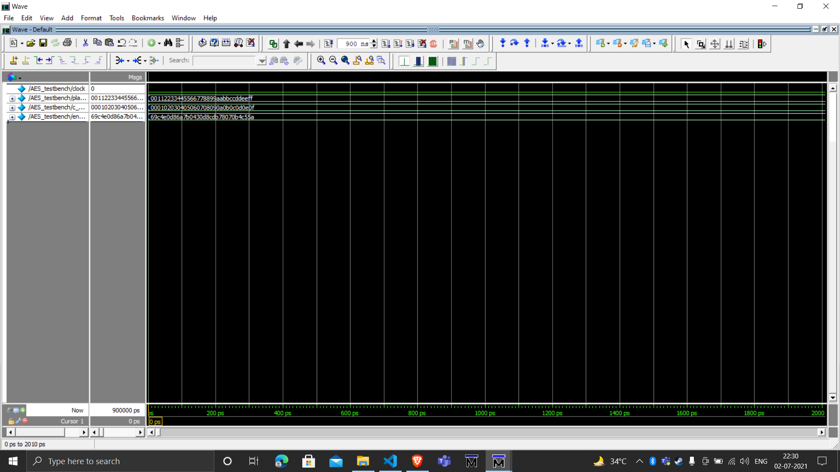
Simulation Result 1

Slide 25
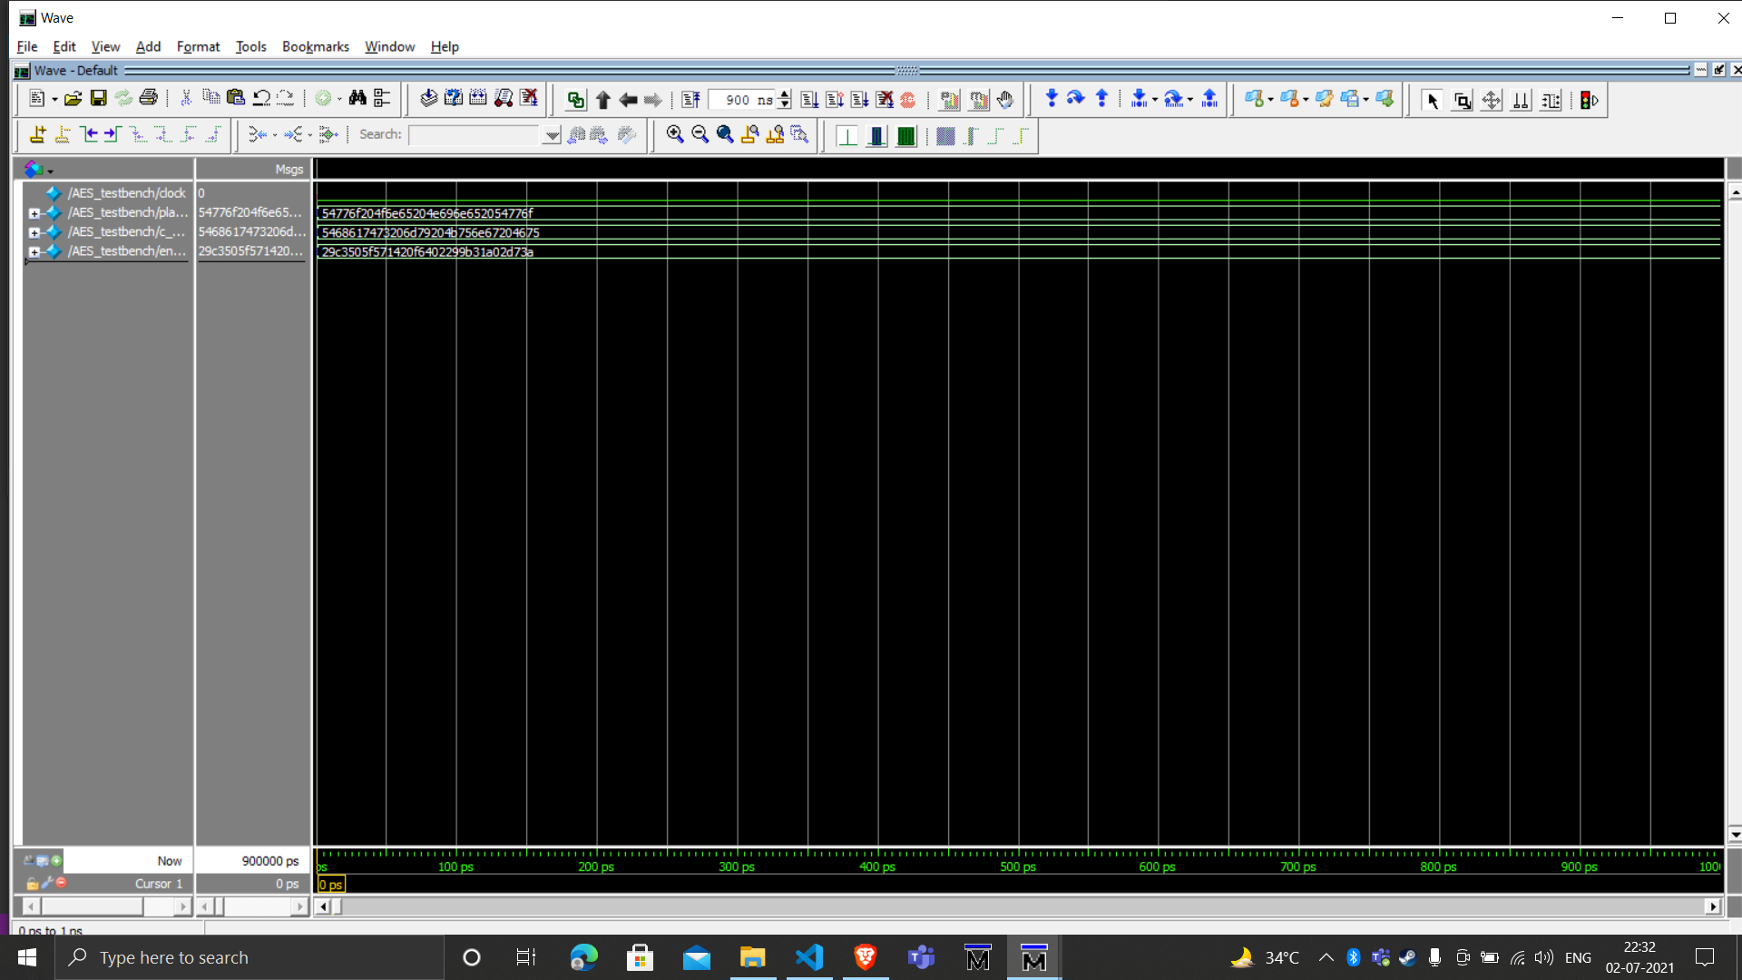
Simulation Result 2

Slide 26
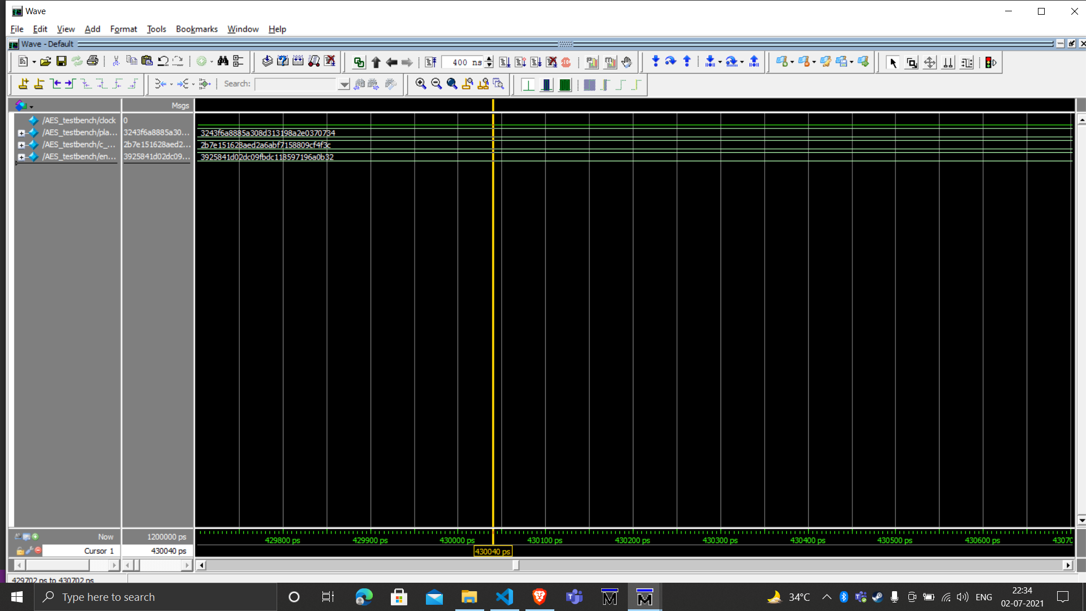
Simulation Result 3

Slide 27
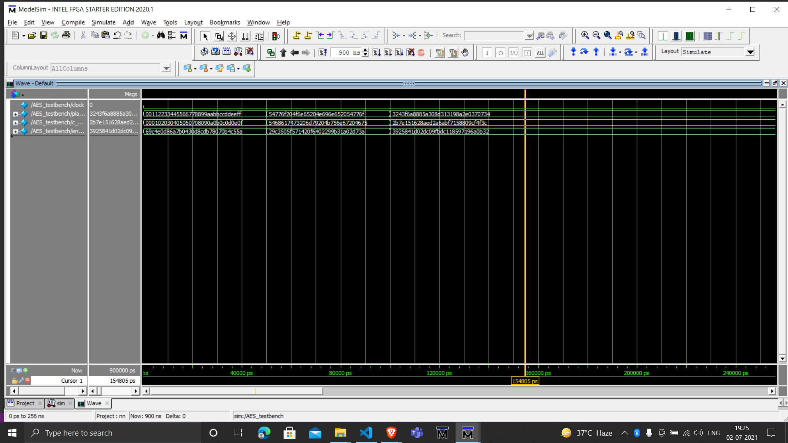
Simulation Result 1-3

Slide 28
Summary & More About AES
> AES is more effective towards brute force attacks. It has 3.4 * 10³⁸ possible128-bit keys.
> Its variable key size feature makes it more efficient.
> AES encryption can be implemented in both hardware and software.
> AES encryption is also significantly faster, so it is ideal for applications, firmware and hardware that require low latency or high output
> It includes self-encrypting disk drives, database encryption and storage.

Slide 29
OUR TIMELINE
Day 1-2
AES ENCRYPTION
> Compile & Organize the data
> Working on Verilog Code (Build)
Day 3-4
Day 8-12
> Getting into the project > Research about the AES Algorithm
Day 4-7
Day 13-15
> Preparing the Block diagram and Flowchart
> Test Bench (Debug) & Simulation
> Prepare the algorithm and data in organised manner
Notes:
> Preparing the algorithm and data in organised manner.

Slide 30
THE TEAM
Sainath Rao P
Shashank Soni
> Research about the AES
> Slides and animation
> Preparing algorithm
> Main module & Test Bench code build
> Report preperation
> Research about the AES
> Slides and animation
> Preparing algorithm
> Shift rows & Subbytes code build
> Report preperation
Dishant Meena
Tadiparthi Aditya
> Research about the AES
> Slides preparation
> Block diagram and Flowchart
> Report preperation
> Round Module code build
> Research about the AES
> Preparing algorithm
> Slides preparation
> Mix Column & Key Genern code build
> Report preperation
Yashraj
> Research about the AES
> Block diagram and Flowchart
> Slides preparation
> Report preperation
> S-box code build

